Slide 1
Unit 1 The Software Problem
Prof. Pooja Patil
KIT’s College of Engineering, Kolhapur

Slide 2
Agenda
1.1 Software Problems
1.2 Cost, schedule & Quality, Scale and change
1.3 Software Development process Modules
1.4 Project Management Process
1.5 Software Processes: Process & Project

Slide 3
Software Problems
1.1
&
1.2
Cost, Schedule, Quality, Scale & Change

Slide 4
3 Main Forces
Cost
1
Schedule
2
Quality
3

Slide 5
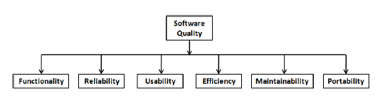
Software Quality Attributes

Slide 6
Other Software Problems
👉 Scale
👉 Change

Slide 7
Software Development Process Models
1.3

Slide 8
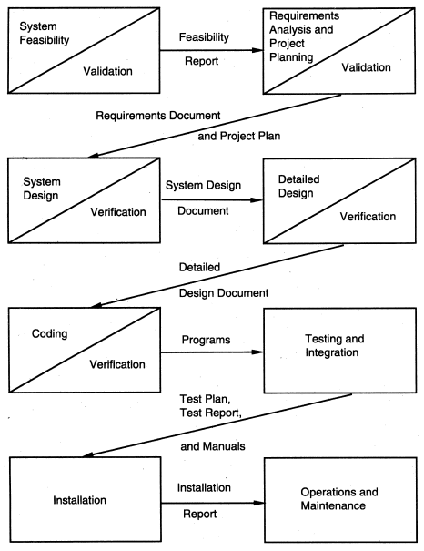
Waterfall Model

Slide 9
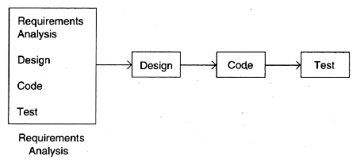
Prototyping

Slide 10
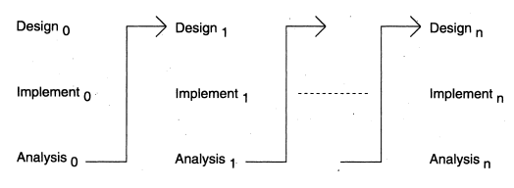
Iterative Development

Slide 11
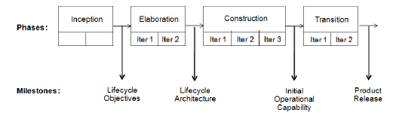
Rational Unified Process(RUP)

Slide 12
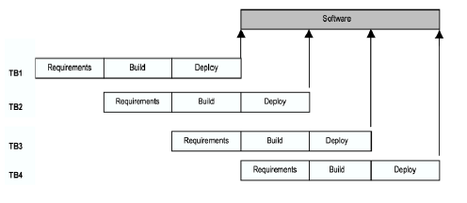
Timeboxing Model

Slide 13
Agile Processes
Working software is the key measure of progress in a project.
For progress in a project, therefore, software should be developed and delivered
rapidly in small increments.
Even late changes in the requirements should be entertained (small-increment
model of development helps in accommodating them).
Face-to-face communication is preferred over documentation.
Continuous feedback and involvement of customer is necessary for developing
good-quality software.
Simple design which evolves and improves with time is a better approach
than doing an elaborate design up front for handling all possible scenarios.
The delivery dates are decided by empowered teams of talented individuals
(and are not dictated).

Slide 14
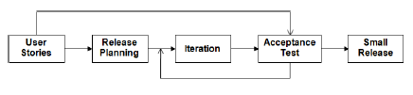
Extreme Programming

Slide 15
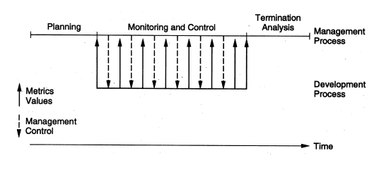
Project Management Process

Slide 16
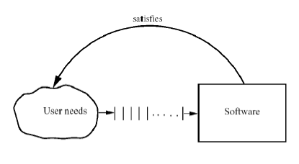
Software Processes: Process & Project

